Slide 1
Preimplantation Genetic Diagnosis (PGD)
Identify genetic conditions in embryo before ET
  Hemophilia
  Cystic ﬁbrosis
  Aneuploidy

Slide 2
PGD
Hemophilia
  Hereditary bleeding disorder
  Absence of a blood protein essential for clotting
  Types A: lack of factor VIII
  Type B: lack of factor IX

Slide 3
PGD
Cystic Fibrosis
  Genetic disease
  Defective gene causes body to produce abnormally thick, sticky mucus that obstruct
    Lungs
    Pancreas

Slide 4
PGD
Aneuploidy
  Having less than or more than normal diploid number of chromosomes
    Monosomy
    Trisomy
    Triploidy

Slide 5
PGD
Performed with IVF
8-cell stage (3 days old) embryo biopsy
Obtain 1-2 blastomeres for molecular analysis

Slide 6
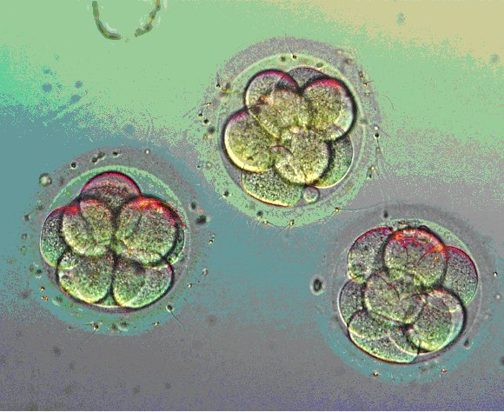
Three day old embryos

Slide 7
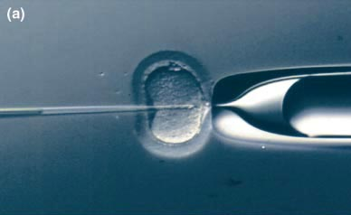

Slide 8
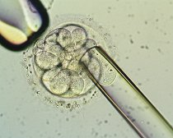

Slide 9
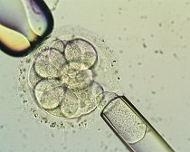

Slide 10
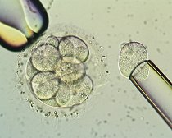

Slide 11
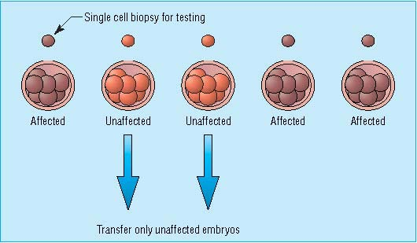

Slide 12
PGD
Genetic analysis
  Polymerase chain reaction (PCR)
  Multicolor ﬂuorescence in situ hybridization (FISH)

Slide 13
Polymerase Chain Reaction (PCR)
In vitro technique for generating large amounts of a specific fragment of DNA from a small amount of template
DNA amplification allows for
  Identification of point mutations
  DNA diagnostics

Slide 14
FISH
Detects
  Number of chromosomes
  Sexing embryos
  Sex chromosome aneuploidy
  Whole-chromosome paints for detection of rearrangements and identiﬁcation of marker chromosomes
  Analyze polar bodies

Slide 15
FISH
Fluorescent probes that bind to speciﬁc chromosomes are labeled with biotin for detection by speciﬁc ﬂuorochrome-conjugated antibodies under a ﬂuorescent microscope

Slide 16
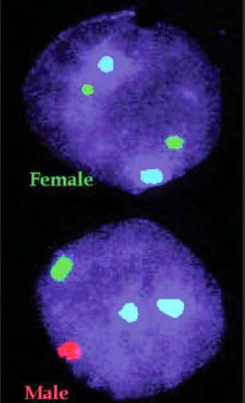
Interphase nucleus
X
Y

Slide 17
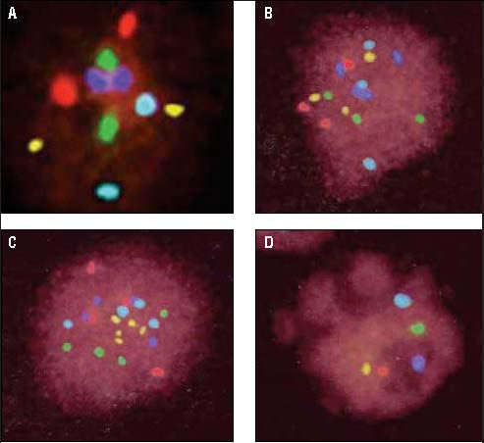
Triploid
Normal Diploid
Tetraploid
Missing chromosomes

Slide 18
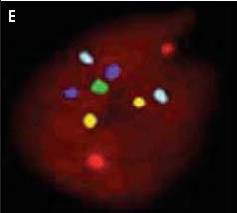
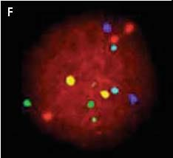
PGD
Monosomy
Double trisomy

Slide 19
PGD
Monosomy
Double trisomy

Slide 20
Sex selection in mammals
There are two methods of sex selection:
1. Embryo sexing. In this case one or two cells are taken from In vitro fertilized 8-cell stage embryo to determine the sex of the embryo before embryo transfer.
2. Sex selection before fertilization. In this case x-bearing sperm are separated from Y-bearing sperm before in vitro fertilization (IVF). (ligand activation of TLR7/8 selectively suppressed the mobility of the X chromosome–bearing sperm (X-sperm) but not the Y-sperm without altering sperm viability or acrosome formation). See the next slides.

Slide 21
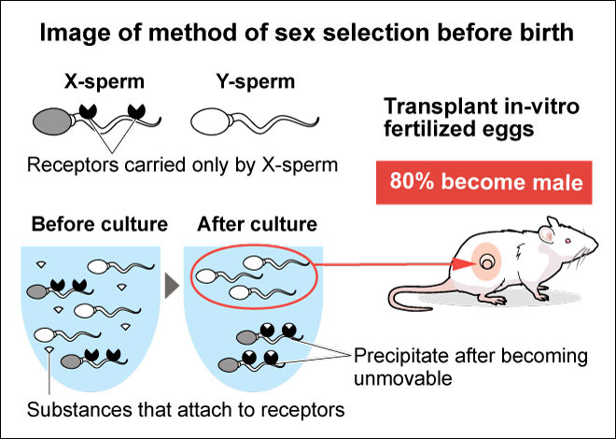
Sex Selection Before Fertilization

Slide 22
Activation of Toll-like receptor 7/8 encoded by the X chromosome alters sperm motility and provides a novel simple technology for sexing sperm
Takashi Umehara, Natsumi Tsujita, Masayuki ShimadaID* Graduate School of Biosphere Science, Hiroshima University, Higashi-Hiroshima, Japan

Slide 23
In most mammals, the male to female sex ratio of offspring is about 50% because half of the sperm contain either the Y chromosome or X chromosome. In mice, the Y chromosome encodes fewer than 700 genes, whereas the X chromosome encodes over 3,000 genes. Although overall gene expression is lower in sperm than in somatic cells, transcription is activated selectively in round spermatids. By regulating the expression of specific genes, we hypothesized that the X chromosome might exert functional differences in sperm that are usually masked during fertilization. In this study, they found that Toll-like receptors 7/8 (TLR7/ 8) coding the X chromosome were expressed by approximately 50% of the round spermatids in testis and in approximately 50% of the epididymal sperm. Especially, TLR7 was localized to the tail, and TLR8 was localized to the midpiece.

Slide 24
. Ligand activation of TLR7/8 selectively suppressed the mobility of the X chromosome–bearing sperm (X-sperm) but not the Y-sperm without altering sperm viability or acrosome formation. The difference in sperm motility allowed for the separation of Y-sperm from X-sperm. Following in vitro fertilization using the ligand-selected high-mobility sperm, 90% of the embryos were XY male. Likewise, 83% of the pups obtained following embryo transfer were XY males. Conversely, the TLR7/8-activated, slow mobility sperm produced embryos and pups that were 81% XX females. Therefore, the functional differences between Y-sperm and X-sperm motility were revealed and related to different gene expression patterns, specifically TLR7/8 on X-sperm.

